Slide 1
Neural Networks: Learning (Week 5)
Coursera – Machine Learning
3 Blue, 1 Brown – Intuition of Backpropagation
NVIDIA – Deep Networks
Notes:
Before Meeting Open
Matlab, Exercise 4
3Blue1Brown video
Nvidia Course – start GPU Exercise 5 + load DIGITS
Notepad++: Modified Network

Slide 2

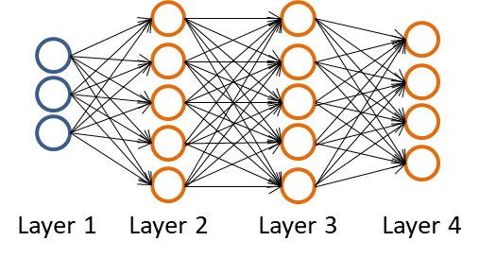
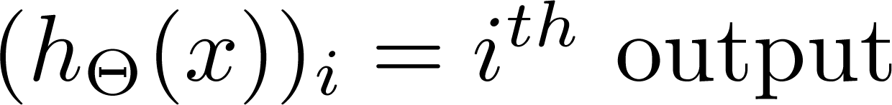
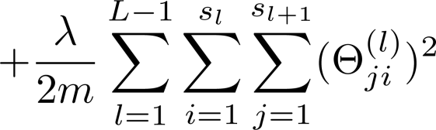
Cost Function
Coursera – Machine Learning
L is number of layers, is the number of neurons in layer (not bias)
m is number of training examples: (x, y)
K classes
Regularization
Costs associated with each neuron
Recall Logistic Regression Cost Function:

Slide 3
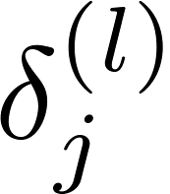
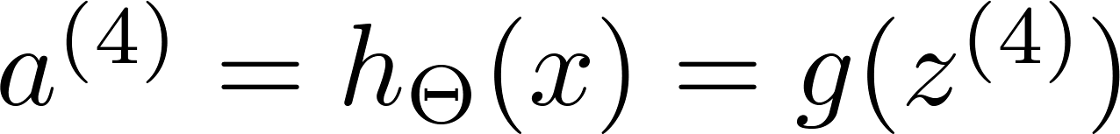
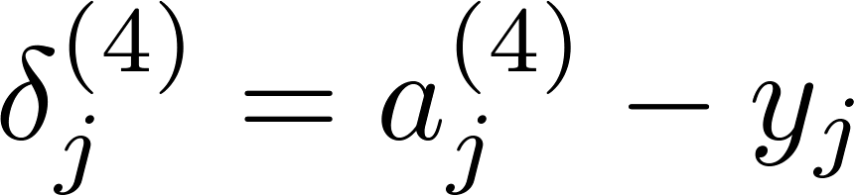
Backpropagation Algorithm
Coursera – Machine Learning
Minimization of the cost function to find optimal parameters theta
like gradient descent for logistic regression
For every node j, compute the error , and recall:
For the last layer (L):
For hidden layers:

Slide 4
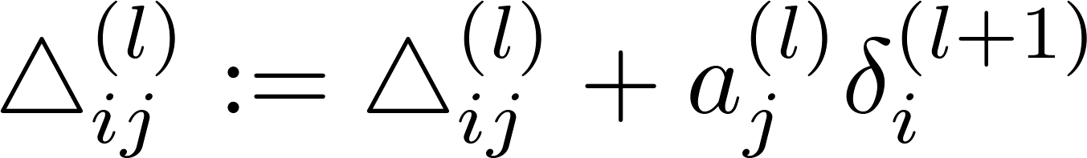
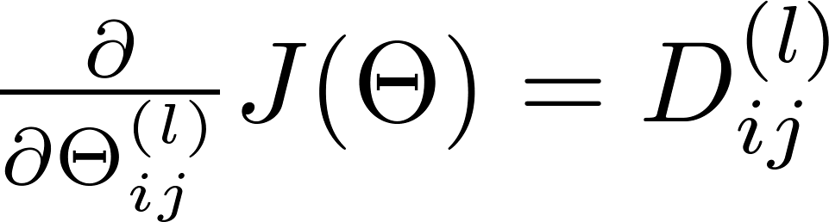
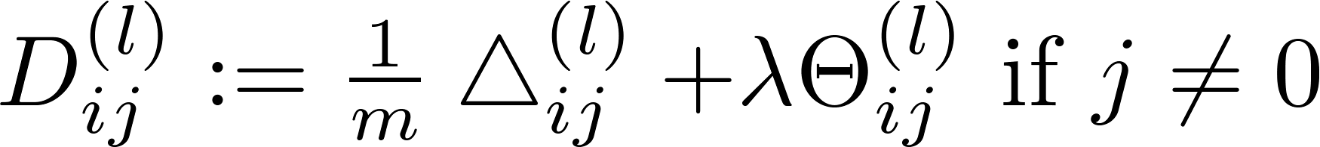
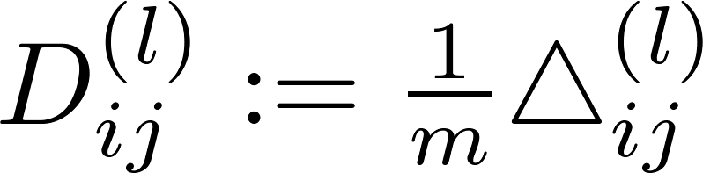

Backpropagation continued
Coursera – Machine Learning
Compute the change:
Then the partial derivatives terms:

Slide 5
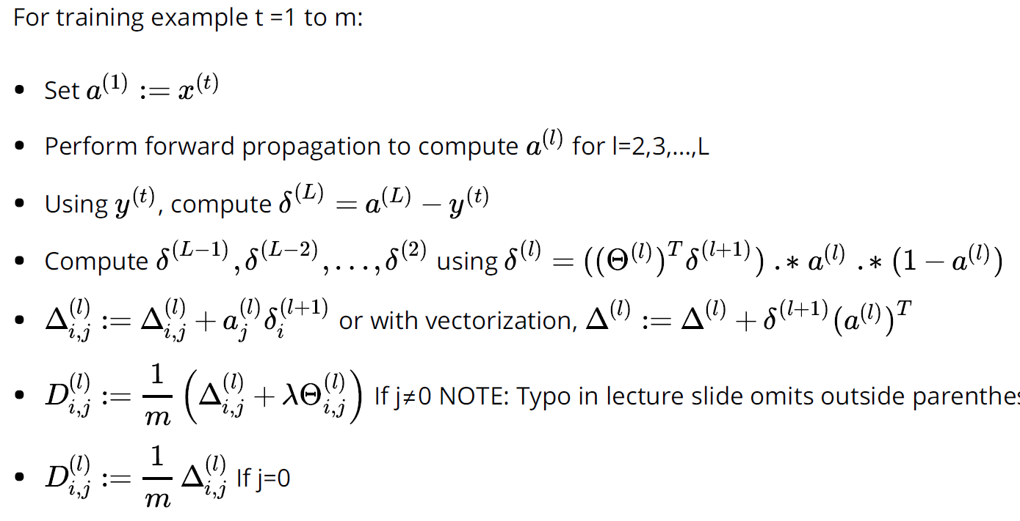
Algorithm
Coursera – Machine Learning

Slide 6
Implementation Note: Random Initialization
Coursera – Machine Learning
When initializing the parameters theta, DO NOT initialize all parameters to zero
All nodes will update to the same value repeatedly
Same weights, same deltas, same change
Instead, initialize to (small) random values in a range centered on zero

Slide 7
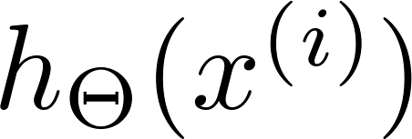
Putting it together
Coursera – Machine Learning
Randomly initialize the weights
Implement forward propagation to get
Compute cost function
Implement backpropagation to compute partial derivatives
(DEBUG ONLY) Use gradient checking to confirm backpropagation
Use gradient descent (or other optimization function) to minimize cost function with the weights in theta
For more details, refer to notes: https://github.com/vkosuri/CourseraMachineLearning/blob/master/home/week-5/lectures/notes.pdf

Slide 8
Backpropagation Intuition
3 Blue, 1 Brown – Intuition of Backpropagation
This video from 3Blue1Brown explains better than I could:
https://www.youtube.com/watch?v=Ilg3gGewQ5U

Slide 9
MNINTS Data Set Exercise
Coursera – Machine Learning
Display sample from dataset (100/5000 handwritten numerals)
Load provided parameter weights for NN with 400+1 input units, 10 output units and 25+1 hidden layer units
Implement Regularized Cost Function

Slide 10
MNINTS Data Set Exercise
Coursera – Machine Learning
Implement Backpropagation Loop
calculate the gradient
implement Sigmoid gradient function first to help
check gradients to confirm
add regularization
use optimizer (ex fmincg) to minimize cost
Initialize parameters (theta) with random weights
Critical – look at result without
Visualize the Hidden Layer

Slide 11
MNINTS Data Set Exercise
Coursera – Machine Learning
Backpropagation Loop:
Set input to the current training ex and perform feedforward pass to compute activations
Calculate output layer’s deltas using true label
Calculate hidden layer’s deltas using gradient
Accumulate gradient of layers together
Normalize to get the NN Cost function’s gradient

Slide 12
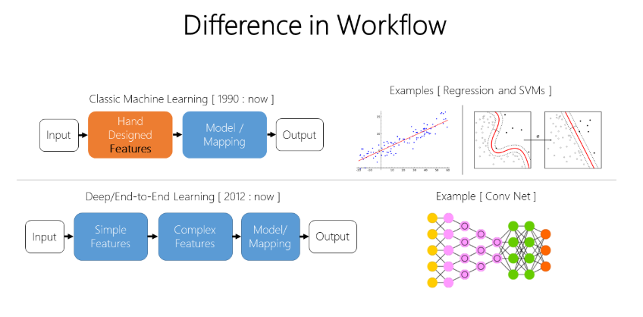
NVIDIA – Deep Networks

Slide 13
NVIDIA Deep Neural Networks Training
NVIDIA – Deep Networks
DIGITS is a tool to train deep neural networks from NVIDIA (Deep Learning GPU Training System) that makes it easy to get started
Select Dataset
Select DNN Model
Train
Test
Works with NVIDIA Caffe and Tensorflow frameworks
We can use pre-trained networks for our tasks instead of starting from scratch
Access to multi-GPU systems over the cloud with safety built in – can’t break it!
More Information: https://developer.nvidia.com/digits

Slide 14
GPU Exercise 5: Object Detection
NVIDIA – Deep Networks
Open DIGITS
Dogs and Cats Data Set
Clone Job – look at all settings available
AlexNet – Customize – Visualize
Data must flow
Math Matters
Replace fully connected layers with a convolution layers -> accept any size image
In Jupyter
change directory, improvement by looking at whole image
If interest/time, can look at Detect Net/COCO dataset
More Information: https://www.nvidia.com/en-us/deep-learning-ai/education/

